Slide 1
Blockchain & Business Application
Lecture:
Mechanics of Bitcoin

Slide 2
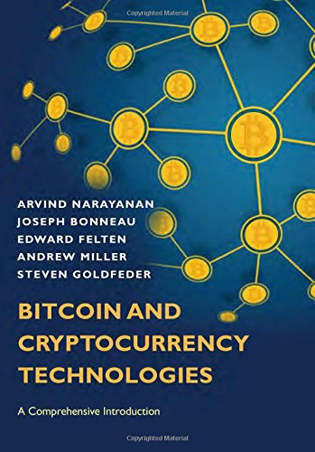
Chapter 3: Mechanics of Bitcoin

Slide 3
First chapters
High level
This chapter:
Real data structures
Real scripts
Language of Bitcoin
Challenging!

Slide 4
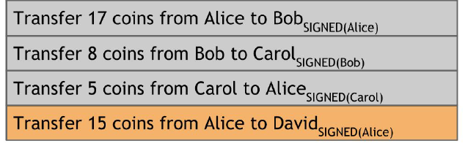
Bitcoin Transactions
Simplified model of a ledger.
Instead of blocks, let’s suppose:
Individual transactions are added to the ledger one at a time.

Slide 5
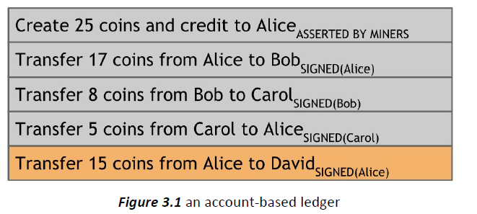
Transactions OK;
Balance?

Slide 6
Balance?
Does Alice have 15 coins to transfer to David?

Slide 7
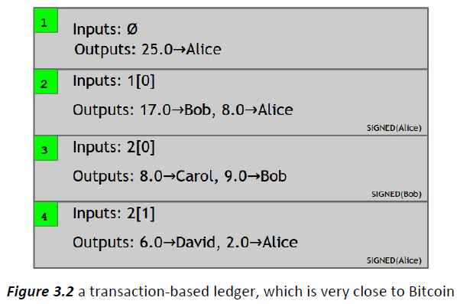

Slide 8
Basic Issues
Change Address
Efficient verification
Consolidating Funds
Joint Payments
Transaction Syntax

Slide 9
Change Address: Why Alice sends to herself?

Slide 10
Change Address
Efficient verification
Hash pointers
Sufficient to scan only referenced → latest block
Consolidating Funds
Bob receives 17 and 2, how to sum up to 19?
Create new self trans. with 2 inputs, 1 output
Joint Payments
Transaction Syntax

Slide 11
Change Address
Efficient verification
Consolidating Funds
Joint Payments
Carol and Bob pays to Alice: 2 Inp (signs), 1 Outp;
Transaction Syntax
Each transaction: Bit strings

Slide 12
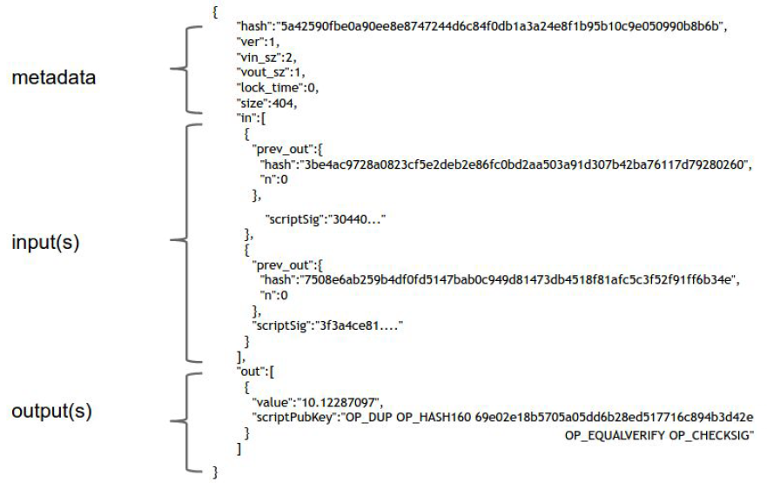

Slide 13
Metadata: some housekeeping information
the size of the transaction,
the number of inputs,
the number of outputs.
the hash of the entire transaction
serves as a unique ID for the transaction.
it allows us to use hash pointers to reference trans’s
Finally there’s a “lock_time”.. later.

Slide 14
Input(s):
form an array, each input has the same form.
specifies a previous transaction, so it contains a hash of that transaction, which acts as a hash pointer to it.
also contains the index of the previous transaction’s outputs that’s being claimed.
signature: we have to sign to show that we actually have the ability to claim those previous transaction outputs

Slide 15
Output(s):
again an array.
each has just two fields.
each have a value,
the sum of all the output values has to be less than or equal to the sum of all the input values.
If the sum of the output values is less than the sum of the input values, the difference is a transaction fee to the miner who publishes this transaction
reciepent address: pk, hash, commands..

Slide 16
Outline
Bitcoin Scripts
Technical aspects
Business applications
Managing & Protecting coins
Local storage
Hot & Cold storage

Slide 17
Bitcoin Scripts
Each transaction output specifies
A script, not just a “public key”
We want it to say:
“this can be redeemed by a signature from the owner of address X”.. But!
Address: Hash of a public key
Does not tell the key
So, how to check the signature?

Slide 18
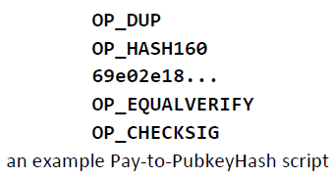
Transaction outputs
Hence, transaction must say:
“this can be redeemed by a public key that hashes to X, along with a signature from the owner of that public key”

Slide 19
Bitcoin Scripts
Script Language built specifically for Bitcoin, called “Script”
Stack-based
Simple & Compact
Native support for cryptographic operations
Compute Hash functions
Compute signatures
Verify signatures

Slide 20
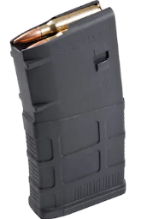
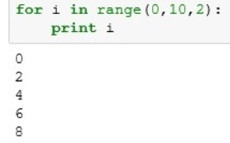
Script
Stack-based
Each instruction executed once
No loops
Number of instructions
How long it can take
How much memory it can use
Not Turing-complete, by design!
Arbitrary miners can’t submit infinite-loops

Slide 21
Only two possible outcomes:
Execute normally with no errors → Valid,
Error → Invalid transaction
Each instruction represented by 1 Byte
256 in total (2⁸=256)
15 disabled, 75 reserved (to be added later)

Slide 22
Instructions
Basic arihtmetic
Basic logic (if-then)
(Not) throwing errors
Crypto instructions
Hash functions
Signature operations
CHECKMULTISIG: Check multiple with one instruction

Slide 23
CHECKMULTISIG requires specifying
n public keys,
and a parameter t , for a threshold.
For this instruction to execute validly,
at least t signatures from t out of n of those valid pk
t out of n specified entities must sign in order for the transaction to be valid.

Slide 24
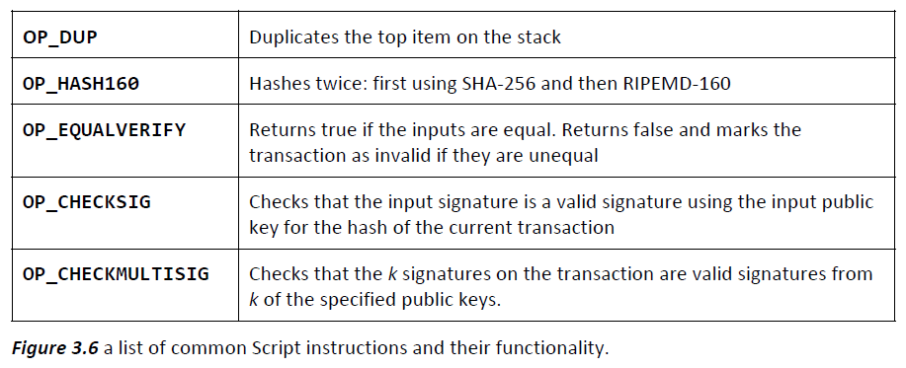

Slide 25
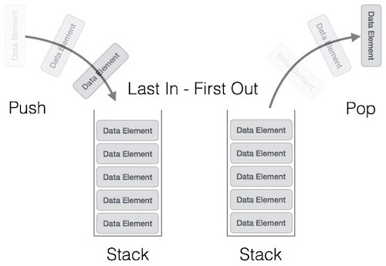
Executing a Script
Stack that we can push data to & pop data from.
We won’t need any other memory or variables.
Two types of instructions:
data instructions (data pushed onto the top)
OpCodes (take input data from top)

Slide 26
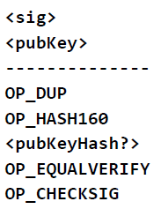
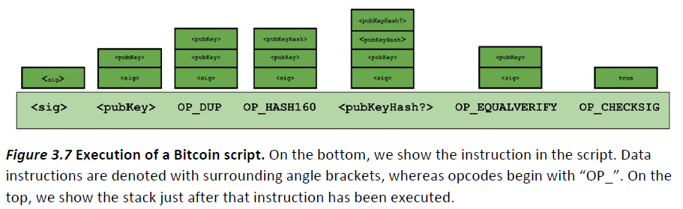

Slide 27
Theory vs. Practice
Theory: Specify arbitrary conditions
Practice: 99.9% of Bitcoin transaction history
The same!
The above script!
Nodes have a “whitelist” of transactions

Slide 28
Business Applications of Bitcoin Scripts
Escrow Transactions
Alice to pay Bob in Bitcoin (after receiving goods)
Bob to send physical item (after receiving Bitcoins)
Alice doesn’t send directly to Bob, rather
creates a MULTISIG requiring 2-of-3 people to sign
Alice, Bob & arbitrator Judy
This transaction added to blockchain
Coins held in escrow between Alice, Bob, Judy
2-of-3 can specify where coins should go

Slide 29
Bob is convinced to deliver the item
Normal case
Both are honest
Both sign a transaction
Redeeming coins from escrow to Bob
No dispute
No need to Judy to involve
Not much less efficient than direct transaction
Requires just one more transaction on the blockchain

Slide 30
Green addresses.
Bob is offline/can’t wait for 1 hour
Bob is a street food seller
Introduction of “Bank”
Not a blockchain but a real life guarantee
Micro-payments
Smart Contracts

